Slide 1
DEMO
Multiple Drones Coordination
FAU CS & CE EGN 4950C
DATE
Group 32: Tutku Gizem Guder
Brenden Martins Matthew Paternoster Matthew Wyatt Tarek Kayali

Slide 2
Introduction - Multiple Drone Coordination System
Multiple Drones Coordination
FAU CS & CE EGN 4950C
Group 32
Our objective is to develop a system for coordinating multiple drones in a realistic 3D simulation environment, which is in response to the growing challenges current emergency response systems face in disaster ridden areas.
These challenges include, but are not limited to, human safety risks, limited drone coordination systems, and inefficient testing environments for the drones. We plan to address these challenges by providing a scalable and efficient MDCS, which can increase the positive outcomes for areas that are facing disaster scenarios.

Slide 3
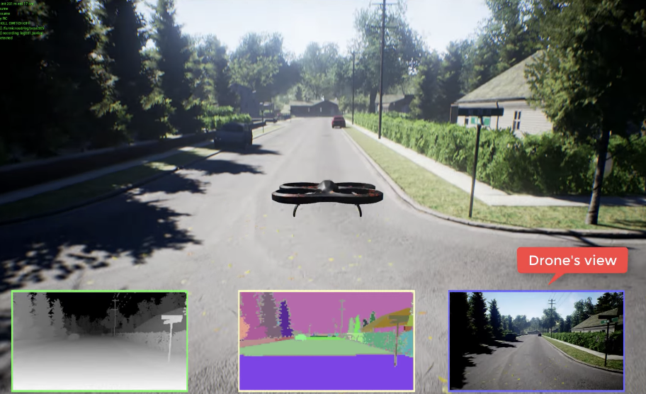
Proposed Solution
Multiple Drones Coordination
FAU CS & CE EGN 4950C
Group 32
Our Project aims to solve some of these challenges by developing a system for coordinating multiple drones in realistic simulated environment to carry out tasks like target detection and rescue operations.
https://production-media.paperswithcode.com/datasets/Screen_Shot_2021-01-29_at_11.03.21_AM.png

Slide 4
Individual Plan
Multiple Drones Coordination
FAU CS & CE EGN 4950C
Tutku Gizem Guder
Tutku Gizem Guder - Target Detection Subsystem
Responsibilities
Integrate object detection and tracking algorithms to ensure effective identification of individuals or hazards.
Set up Microsoft AirSim to simulate realistic disaster scenarios.
Select suitable algorithms for object detection and SORT for tracking.
Milestones
Install and Configure Airsim usingEngine
Research Models and Algorithms
Simulate the Process
Fine-tune the Model
Add Complex Scenario
Testing

Slide 5
Progression
Multiple Drones Coordination
FAU CS & CE EGN 4950C
Tutku Gizem Guder
Done
Install and Configure Airsim using Unity
Research Models and Algorithms
Implement Object Detection
Implement Keeping a Safe Distance Between
Implement Object Following
Implement Clearing the Object for the next object
Doing
Implementing the algorithms into Unreal Engine
Being aware of the environment to stop itself from hitting non-target objects
To Do
Fine-tune the Model
Add Complex Scenario
Testing
I was able to install and configure Unreal Engine, however my computer could not handle its high rendering, and slowed down enough to affect the implementation
I decided to do the test runs and try out different implementations in Unity to speed up to process

Slide 6
Potential Challenges with the Subsystem
Multiple Drones Coordination
FAU CS & CE EGN 4950C
Tutku Gizem Guder
Challenges:
Transferring the data from Unity to Unreal Engine
Synchronizing real-time data from simulated environments to the detection system.
Ensuring the detection model remains robust across diverse scenarios.
Achieving the right balance between detection accuracy and processing speed.
Ensuring that the system processes sensor data fast enough for real-time applications during disaster response.

Slide 7

Demo
Multiple Drones Coordination
FAU CS & CE EGN 4950C
Tutku Gizem Guder

Slide 8
Responsibilities
Tarek Kayali
Develop and refine flight control algorithms for stable drone operation.
Implement communication between the control system and AirSim for real-time simulations.
Ensure smooth and precise maneuverability in different simulated environments.
Optimize responsiveness to dynamic environmental factors (e.g., wind, obstacles).

Slide 9
Milestones
Tarek Kayali
Basic Flight Control Implementation
Refining and calibrating the Target Detection Subsystem
Performance Optimization
Final Testing & Validation

Slide 10
Progression
Tarek Kayali
✅ Completed Activities:
Set up the control framework within AirSim.
Improved machine learning model for real-time data processing
Established basic flight controls (takeoff, landing, navigation).
Integrated basic waypoint navigation.
🔄 Ongoing Activities:
Implementing real-time adjustments for dynamic conditions.
Improving stability and accuracy of flight paths.
Fine-tuning PID controller for smoother drone motion.

Slide 11
Tarek Kayali
⏳ To-Do Activities:
Integrate AI-assisted autonomous flight capabilities.
Conduct stress tests for extreme conditions (high wind, low visibility).
Optimize control responsiveness for real-world application.

Slide 12
Potential Challenges in the Control Subsystem
Tarek Kayali
Latency Issues – Delays in sending and receiving commands in real-time simulations.
Environmental Variability – Handling unpredictable elements like wind, rain, and obstacles.
Sensor & Data Synchronization – Ensuring control inputs match real-time sensor feedback.
Computational Load – Balancing processing power for complex flight maneuvers.
Integration with Other Subsystems – Ensuring seamless communication with UI, Data Management, and Target Detection.

Slide 13

Individual Plan
Multiple Drones Coordination
FAU CS & CE EGN 4950C
Brenden Martins
Brenden Martins - Simulation Management Subsystem
Responsibilities
Configure and optimize the AirSim simulation environment.
Design and test realistic 3D terrains, weather conditions, and obstacles.
Ensure integration with multi-drone algorithms for seamless operation.
Milestones
Install and configure AirSim; familiarize with API.
Develop and test terrains (urban, forest, disaster scenarios).
Mapped out collision for each building, terrain, etc.
Implemented rudimentary weather/climate system console (rain, snow, fog, etc.)
Created a control scheme for the drone as a backup to the remote system.
Collaborate with the other subsystems.

Slide 14
Progression
Multiple Drones Coordination
FAU CS & CE EGN 4950C
Brenden Martins
Done
Configure Airsim using Unreal Engine 4.27
Researched how to properly operate within the conventions of UE 4.27
Mapping collision to the 3D simulated environment
Texturing/rendering the environment
Implemented rudimentary dynamic weather system with console
Programmed a rudimentary control scheme to work with the keyboard for control of the drone.
In Progress
Further enhancing the weather control system
A more detailed collision mapping of the environment
To Do
Create an even more realistic environment possibly utilizing GIS mapping + 3DEP
Start the process of incorporating all subsystems into one

Slide 15
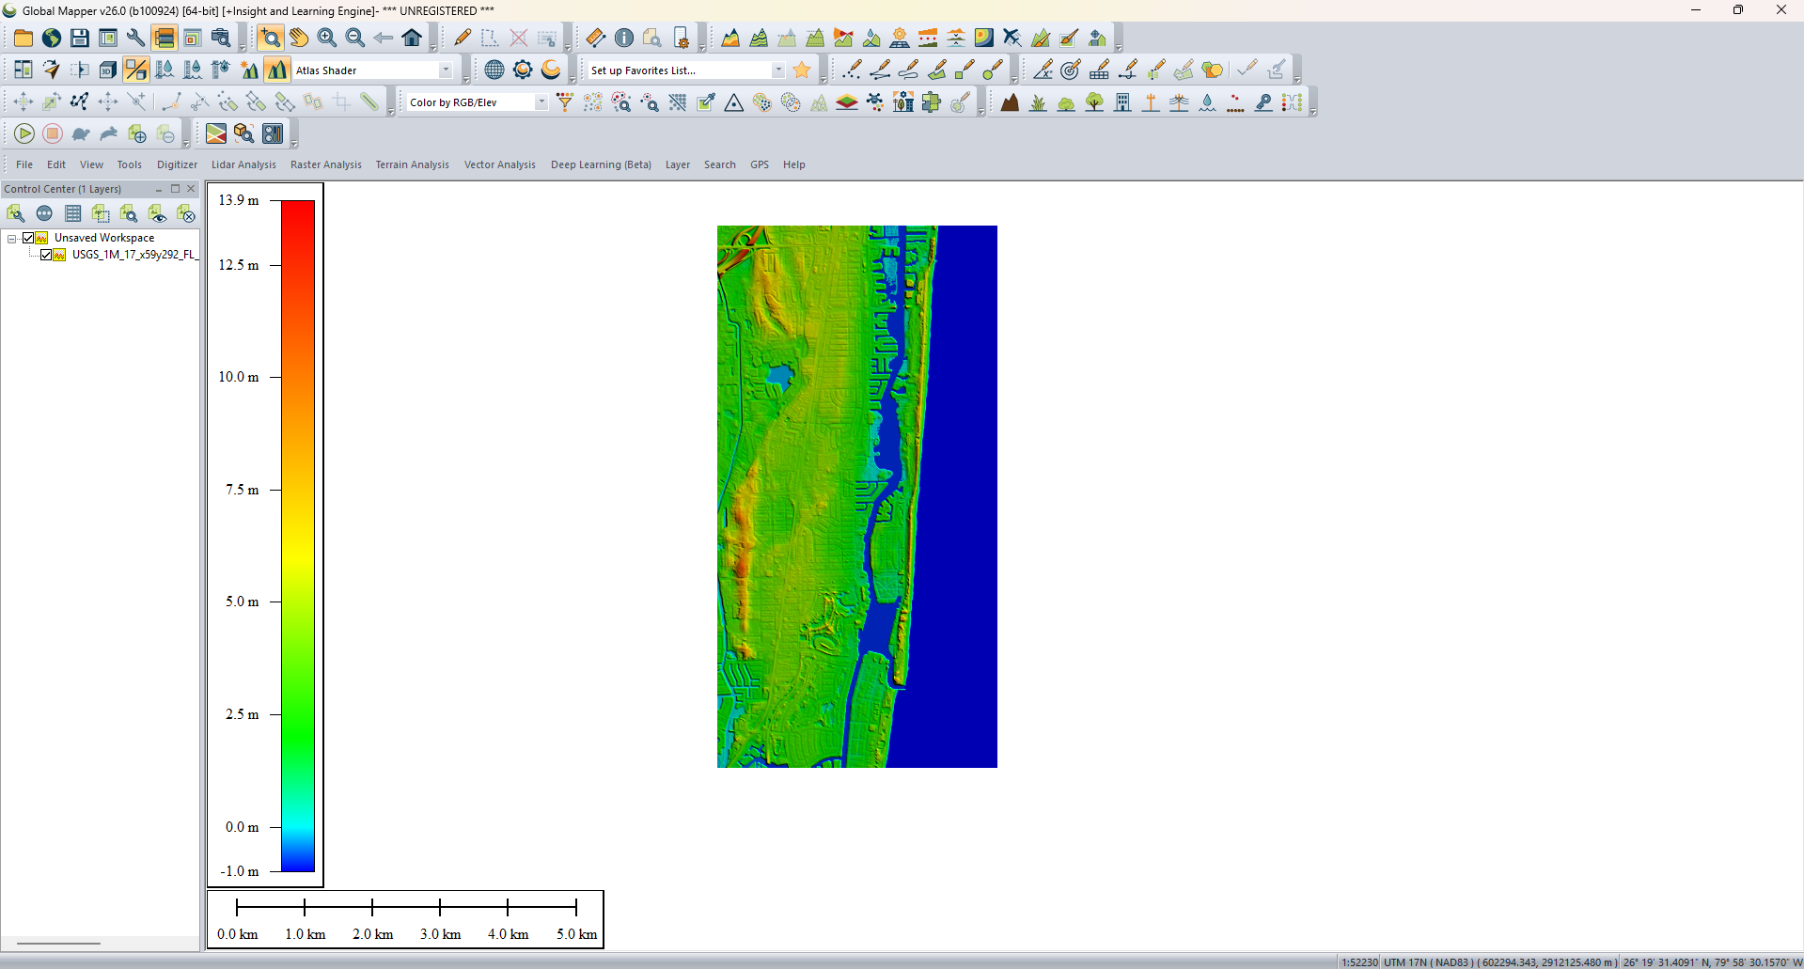
Multiple Drones Coordination
FAU CS & CE EGN 4950C
Brenden Martins

Slide 16
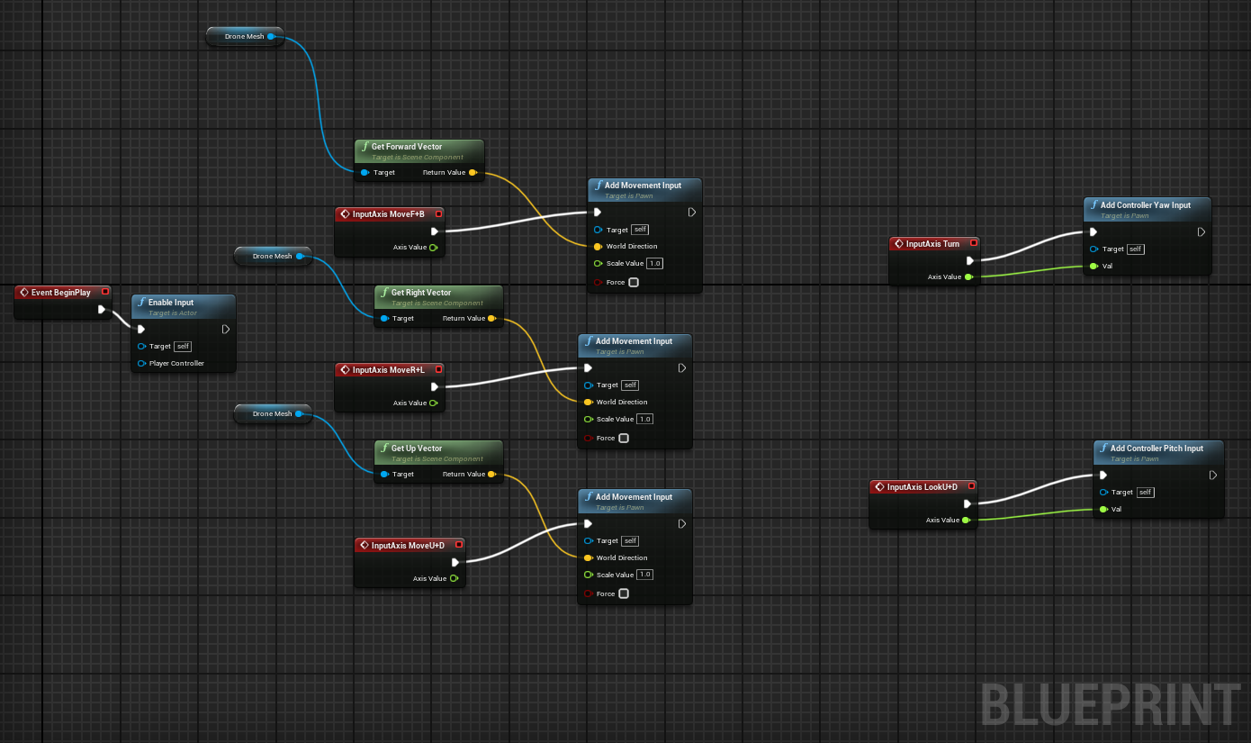
Multiple Drones Coordination
FAU CS & CE EGN 4950C
Brenden Martins

Slide 17
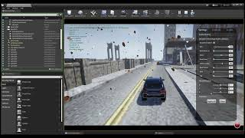
Multiple Drones Coordination
FAU CS & CE EGN 4950C
Brenden Martins

Slide 18
Individual Plan
Multiple Drones Coordination
FAU CS & CE EGN 4950C
Matthew Paternoster
Matthew Paternoster - User Interface
Responsibilities:
Designing and developing the user interface using React.
Integrating interactive mapping of drone locations.
Implementing real time data handling for live drone tracking.
Enhanced UI aesthetics for a professional and user-friendly experience.

Slide 19
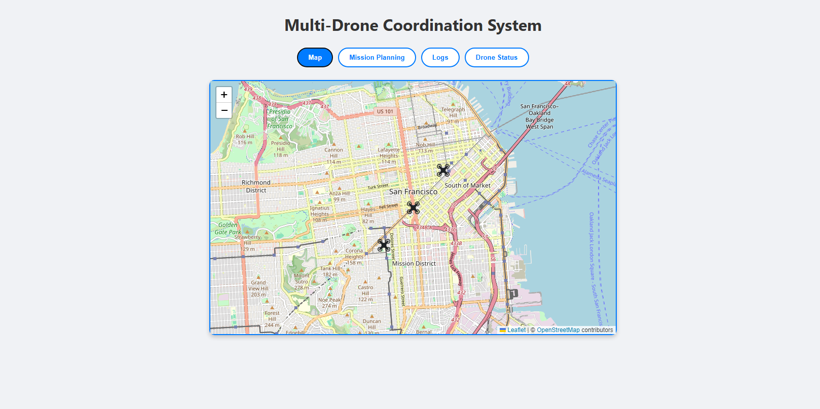
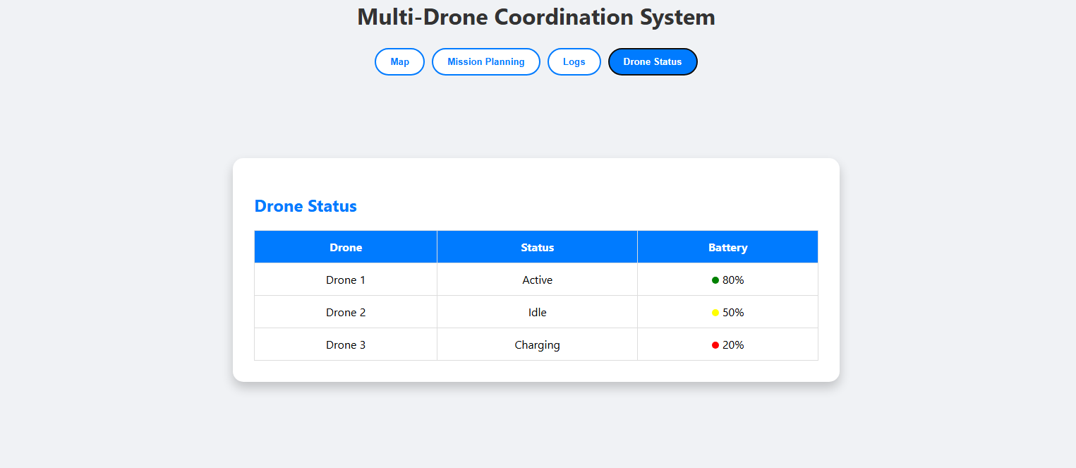
Multiple Drones Coordination
FAU CS & CE EGN 4950C
Matthew Paternoster

Slide 20
Next Steps/Challenges
Multiple Drones Coordination
FAU CS & CE EGN 4950C
Matthew Paternoster
Enhanced Real-Time Features:
Possibly add more detailed drone metrics (altitude, speed, live video feed).
Advanced Mission Planning:
Enable interactive mission planning directly on the map.
Improved Logs and Analytics:
Develop comprehensive logging with filtering and searching capabilities.
Implement analytics dashboards for mission performance.

Slide 21
Individual Plan
Multiple Drones Coordination
FAU CS & CE EGN 4950C
Matthew Wyatt
Matthew Wyatt - Data Management and Communications Subsystems
Responsibilities / Objective
Facilitate reliable data exchange between drones and control systems.
Ensure stable connectivity and low-latency communication across
all drones.
Store and manage large volumes of operational data securely.
Provide scalable data storage capabilities for real-time access and
archival.
Major Milestones
Created MySQL server and migrated to from lamp.cse.fau.edu to Freesqldatabase.com for external access.
Created API using ExpressJS to communicate with other subsystems.
Verified that these data outlets are ready to be integrated with the other subsystems.

Slide 22
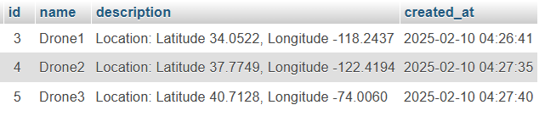
Progression
Multiple Drones Coordination
FAU CS & CE EGN 4950C
Matthew Wyatt
Matthew Wyatt - Data Management and Communications Subsystems
Done
Analyzed project requirements and established a clear understanding of the project objectives.
Reviewed the MySQL database schema, data integrity, and relevance.
Continued evaluation and optimization of the MySQL database for better performance.
Reviewed the planned API for syncing data between the UI and MySQL.
Migrated the MySQL server from lamp.cse.fau.edu to Freesqldatabase.com for external access.
To Do
Ensure that the data between the MySQL database and AirSim remains synchronized.
Maintain data consistency between the database and the simulation environment.
Meet with the group members responsible for the User Interface, Simulation Management, and Target Detection subsystems.
Coordinate and advance the integration efforts to ensure all components are aligned and integrated smoothly.

